Slide 1

01
DOM
Let’s Start

Slide 2
DOM
DOM = Document Object Model
But in simple words…
DOM is the browser’s way of understanding your webpage.
When you open a webpage:
    The browser reads your HTML file
    Converts it into a tree-like structure
    This structure is called the DOM
    JavaScript uses this structure to change anything on the page
    (text, color, images, buttons, etc.)

Slide 3
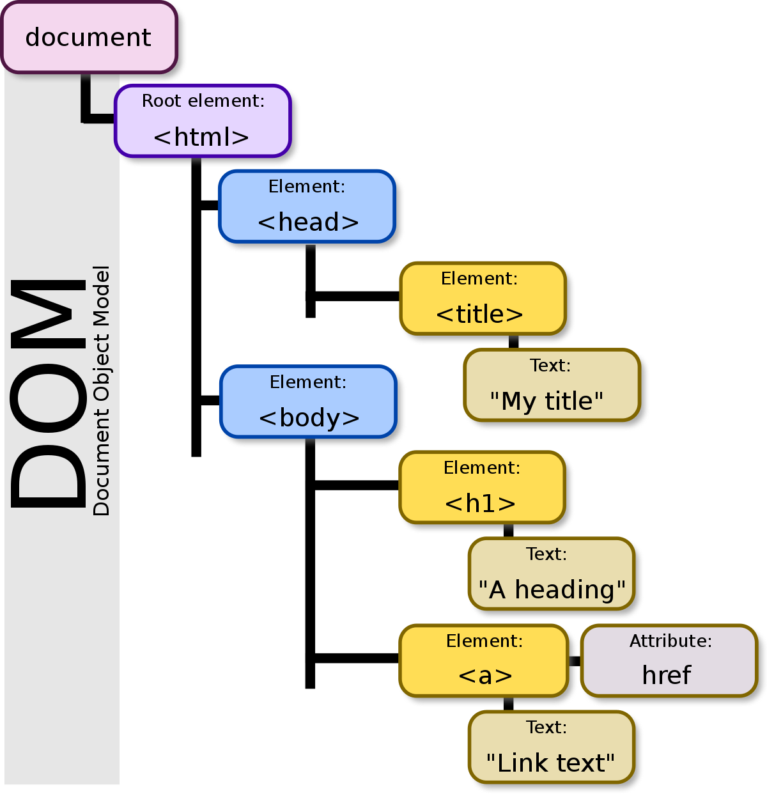
DOM

Slide 4
DOM
HTML is like a written recipe on paper.
But your phone cannot edit the paper.
So your phone creates a digital version of the recipe inside its memory.
This digital version = DOM
Now you can:
✔ Change ingredients
✔ Add new items
✔ Delete steps
✔ Highlight important points
Just like JavaScript can change anything on the webpage through the DOM.

Slide 5
DOM
Think of DOM Like a Family Tree
The webpage is like a big family.
Every HTML tag (like <h1>, <p>, <div>) becomes a member in the tree.
This tree is called the DOM Tree.
HTML
├── HEAD
└── BODY
├── H1
└── P

Slide 6
DOM
DOM vs HTML
HTML | DOM
File written by the developer. | Structure created by the browser.
Just text. | Objects in memory.
Cannot be changed directly by JavaScript. | Can be changed anytime by JavaScript.

Slide 7
DOM
Why is DOM Useful?
JavaScript can:
Read
Find an element
“What is written inside the <h1> tag?”
Modify
Change text, style, color
Make a heading red
Add
Create new elements dynamically
Add a new paragraph
Delete
Remove elements
Delete an image or a button
DOM is an object-based representation of a webpage created by the browser, which JavaScript can read and change anytime.

Slide 8
DOM
What is a Node?
A node is simply anything inside the DOM Tree.
Every part of the webpage becomes a node.
There are different types of nodes, and each plays a role.
Element Node
Created from HTML tags
Examples: <div>, <p>, <h1>, <img>
These are the building blocks of the page.
<div>Hello</div>
Element Node → <div>

Slide 9
DOM
2. Text Node
The actual text inside elements
Example: "Hello world"
Browser always keeps text inside a text node.
<div>Hello</div>
Element Node → <div>
Text Node → "Hello"
3. Comment Node
Created from <!-- comments --> in HTML
Not visible on the page
Useful for notes in code
<!-- This is a comment -->

Slide 10
DOM
4. Document Node
The topmost node
Represents the entire webpage
Everything starts from here
Document
└── html
└── body
└── ...

Slide 11
DOM
DOM TREE
Document
├── Comment Node ("Title section")
├── Element Node <h1>
│ └── Text Node ("Welcome")
└── Element Node <p>
└── Text Node ("This is my page")
<!-- Title section -->
<h1>Welcome</h1>
<p>This is my page</p>
DOM Tree = Structure of the webpage created by the browser
Node = Any part of the DOM Tree
Types of Nodes:
Element Node → HTML tags
Text Node → Actual text
Comment Node → Notes in HTML
Document Node → Root (top-most)

Slide 12
DOM
DOM Selection Methods
We use DOM selection methods to find elements on a webpage so that JavaScript can read or modify them.
document.querySelector()
  Returns the first matching element.
  Accepts CSS selectors (very powerful).
document.querySelector("h1"); // first <h1>
document.querySelector(".title"); // class = title
document.querySelector("#box"); // id = box
document.querySelector("p span"); // span inside p
2. document.querySelectorAll()
Returns all matching elements
Returns a NodeList
document.querySelectorAll("p"); // all <p> elements

Slide 13
DOM
3. document.getElementById()
Selects one element
Only by ID
document.getElementById("header");
4. document.getElementsByClassName()
Selects all elements with a class
Returns an HTMLCollection
document.getElementsByClassName("item");
5. document.getElementsByTagName()
Selects all elements by tag name
Returns an HTMLCollection
document.getElementsByTagName("div");

Slide 14
DOM
NodeList vs HTMLCollection
Feature | NodeList | HTMLCollection
Returned by | querySelectorAll() | getElementsByClassName(), getElementsByTagName()
Static or Live? | Static (does NOT update automatically) | Live (updates when DOM changes)
Can use forEach? | Yes | ❌ Not directly
Can contain? | Any node (elements, text, comments) | Only element nodes
Looks like an array? | Yes (array-like) | Yes (array-like)
NodeList = Photo → Once taken, it doesn’t auto-update
HTMLCollection = CCTV Live Camera → Updates when elements change

Slide 15
DOM
DOM Manipulation – Basics
Once you select an element, you can change it.
.innerText
Shows only visible text
Ignores hidden text
Slow (recalculates layout)
element.innerText = "Hello!";
element.textContent = "Welcome!";
.textContent
Shows all text (even hidden)
Faster

Slide 16
DOM
.innerHTML
Reads or replaces HTML inside an element
Can insert tags
element.innerHTML = "<b>Bold Text</b>";
element.style.color = "red";
element.style.background = "yellow";
element.style.fontSize = "30px";
.style → Modify CSS
Change color, size, background, etc.
element.setAttribute("id", "header");
element.getAttribute("href"); // get link URL
.setAttribute() & .getAttribute()
Used to add, read, or change attributes.
element.classList.add("active");
element.classList.remove("hidden");
element.classList.toggle("dark-mode"); // ON/OFF
.classList
Used to manage CSS classes.

Slide 17
DOM
Browser Developer Tools → Elements Panel
(Works in Chrome, Edge, Firefox)
This is the actual DOM viewer inside the browser.

Slide 18
DOM
Open any webpage
Example: google.com or your own HTML page.
2. Right-click anywhere on the page
Select: Inspect or Inspect Element
3. A panel opens on the right/bottom
Go to the Elements tab (in Chrome by default it's already selected).
What You see here IS THE DOM.
It shows:
All HTML elements converted into a DOM tree
You can expand and collapse nodes
CSS of selected element (on the right side)
Live changes visible instantly

Slide 19
DOM
How You Can Demonstrate DOM Live
✔ Step 1 — Select an element
Click on the arrow icon 🔍 in DevTools → click a heading on the page
It highlights the corresponding DOM node.
✔ Step 2 — Edit text directly
Double-click the <h1> inside DevTools → change the text.
Students will see:
The webpage changes immediately.
👉 This shows JavaScript doesn’t change HTML,
it changes DOM, and DOM updates the page.
✔ Step 3 — Add a new element
Right-click inside <body> → “Add element”
Type:
<p>Hello Students!</p>
It instantly appears on the webpage.
“Whatever you see in this Elements panel is the DOM.
This is the browser’s internal version of your webpage.
If we change anything here, the webpage changes immediately.”

